Slide 1
The World Muscle Society: Supporting science around the globe

Slide 2
Mission
“A global, multidisciplinary community committed to advancing the science of neuromuscular disorders and the care for people living with them.”

Slide 3
Values
Educational (continually learning and providing education and guidance to the next generation of neuromuscular disorder specialists through training, mentoring, championing, coaching and leading)
Scientific (driving scientific discoveries and innovation; making decisions based on scientific evidence rather than opinion or instinct)
Collaborative (a multidisciplinary community drawing learning from one another and working together towards a shared goal)
Inclusive (welcoming everyone, supporting one another, improving access for colleagues and patients)

Slide 4
Supporting early career members
To develop the next generation of neuromuscular specialists we offer support and financial benefits to early-career members including:
Reduced membership fees and Congress attendance fees for students and people early in their neuromuscular careers
A membership grant to cover the costs of membership for individuals who do not have the financial means: www.worldmusclesociety.org/page/membership-grant
Fellowships to support in-person attendance at our annual Congress: www.wms2024.com/page/fellowships
Visit www.worldmusclesociety.org/page/early-career-researchers for details of our wider early careers support and https://www.wms2024.com/page/early-career-information for our Congress specific information

Slide 5
Supporting early career members
The WMS Congress
This five-day event is an opportunity to learn and network. Delegates will get to meet other early career researchers as well as established experts; the clinicians and scientists who have been leading our field for decades.
We also invite early career researchers to bring their work and participate in our poster presentations.
As well as the Congress, we:
Host monthly virtual Myology Cafés
Post news, newsletters, jobs, research and interviews on our website
Publish the NMD Journal
Have various Committees to support membership activities and initiatives

Slide 6
Education
Education is at the heart of our mission and the first of our values
As an academic society, we promote education for all our members, not just those at the early stage of their careers.
Our annual Congress features a 1.5-day Pre-Congress Teaching Course, delivered and attended by established and young physicians, researchers, therapists, and neuropathologists from across the world.
Delegates learn about the modern approaches and developments in the field of neuromuscular disorders.
Our Education and Development Opportunities Committee provides learning orientation through the distribution of curated educational material.

Slide 7
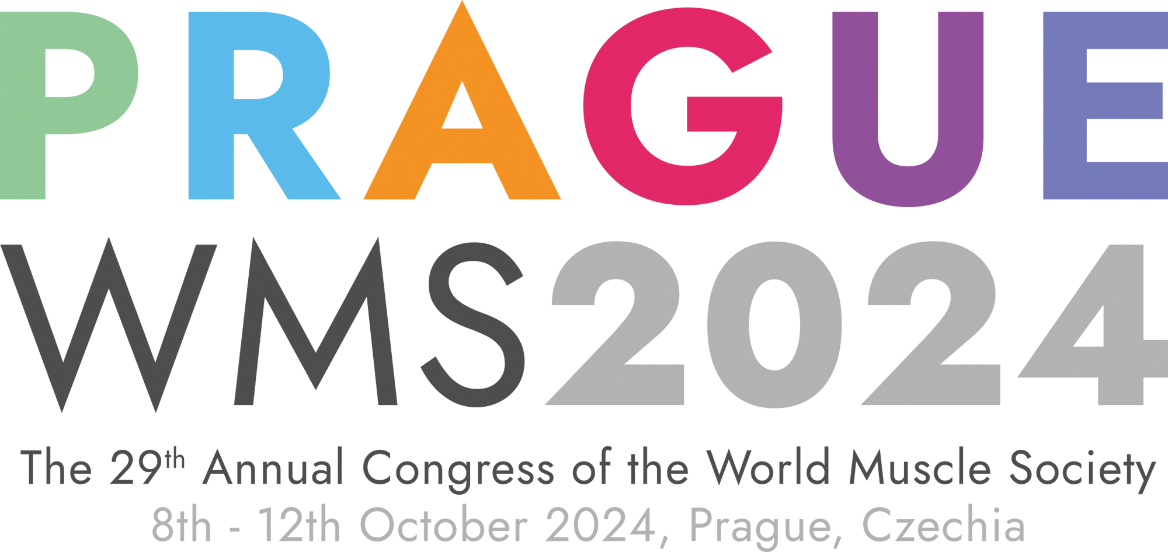
See you in Prague!
Notes:
Save the Date – Congress - Option 3

